Slide 1

Unit-2 Object Oriented Concepts
Object-Oriented Programming
2305CS102
Prof. Swati R Sharma
Computer Engineering Department
swati.sharma@darshan.ac.in

Slide 2
Syllabus
Sr. | Content | T Hrs | W %
1 | Introduction to JAVA | 10 | 20
2 | Object Oriented Concepts | 15 | 22
3 | Inheritance and Abstraction | 12 | 20
4 | Package, Exception Handling and Multithreading | 13 | 20
5 | IO Programming and Collection Framework | 10 | 18

Slide 3
Unit-2

Looping
What we will learn
Thinking of Class
Object and its relationships
Object Oriented Programming Concepts
Encapsulation
Inheritance
Polymorphism
Abstraction
Class, object, object reference
Method, method overloading
constructor, constructor overloading
recursion, passing and returning object,
this and static keyword, access control
nested class
String, StringBuffer
Math Class, Wrapper classes

Slide 4
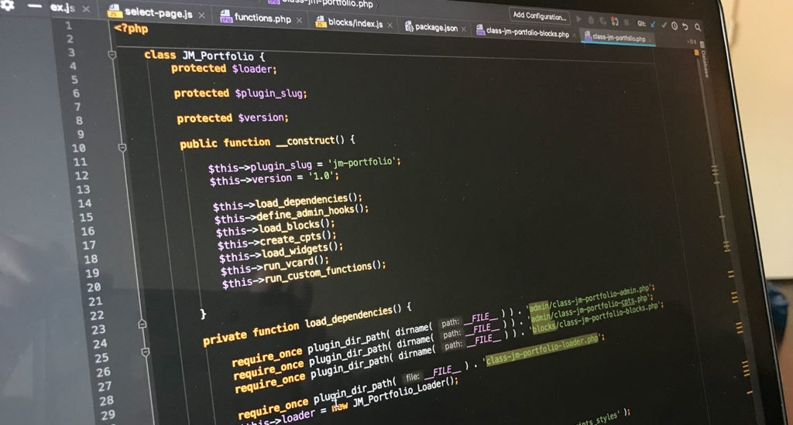
What is OOP?
OOP(Object-Oriented Programming) is a programming paradigm that is completely based on ‘objects’.
Object-Oriented Programs insists to have a lengthy and extensive design phase, which results in improved designs and fewer defects.
Object-oriented programming provides a higher level way for programmers to envision and develop their applications.
In an object-oriented programming language, less emphasis is placed upon the flow of execution control. Instead, the program is viewed as a set of objects interacting with each other in defined ways.
An OOP programmer can bind new software objects to make completely new programs/system.

Slide 5
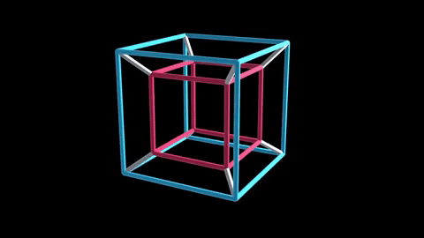
What is an Object?

Slide 6
Philosophy of Object Oriented
Our real world is nothing but classification of objects
E.g. Human, Vehicle, Library, River, Watch, Fan, etc.
Real world is organization of different objects which have their own characteristics, behavior
Characteristic of Human: Gender, Age, Height, Weight, Complexion, etc.
Behavior of Human: Walk, Eat, Work, React, etc.
Characteristic of Library: Books, Members, etc.
Behavior of Library: New Member, Issue Book, Return Book etc.
The OO philosophy suggests that the things manipulated by the program should correspond to things in the real world.
Classification is called a Class in OOP
Real world entity is called an Object in OOP
Characteristic is called Property in OOP
Behavior is called Method in OOP

Slide 7

What is an Object?

Slide 8






What is an Object?
Pen
Board
Laptop
Bench
Projector
Bike
Physical objects…

Slide 9
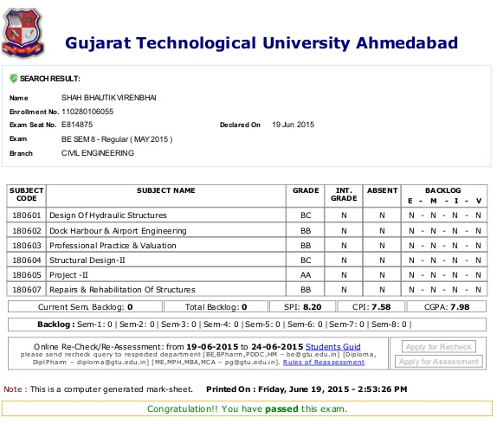

What is an Object? (Cont…)
Result
Bank Account
Logical objects…

Slide 10




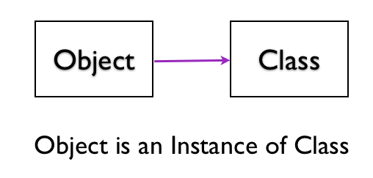
What is an Object?
An Object is a key to understand Object Oriented Technology.
An entity that has state and behavior is known as an object. e.g., Mobile, Car, Door, Laptop etc
Each and every object posses
Identity
State
Behavior
OBJECT

Slide 11






Object: A Real-World Entity
CAR
Audi | Lamborghini | Benz | Toyota | Ferrari

Slide 12

Object: A Real-World Entity
OBJECT: CAR
Events
On_Start
On_Parked
On_Brake
Properties (Describe)
Manufacturer
Model
Color
Year
Price
Methods (Actions)
Start
Drive
Park

Slide 13
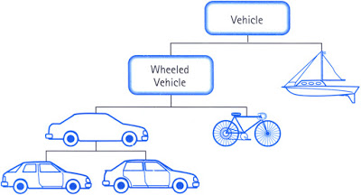
Object: A Real-World Entity

Slide 14
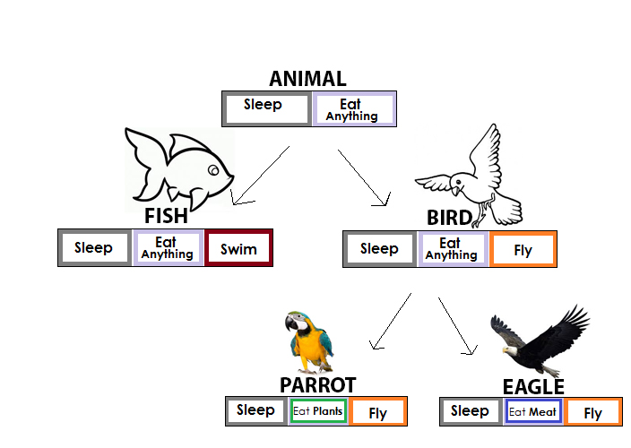
Object: A Real-World Entity

Slide 15
Classes and Objects

Slide 16
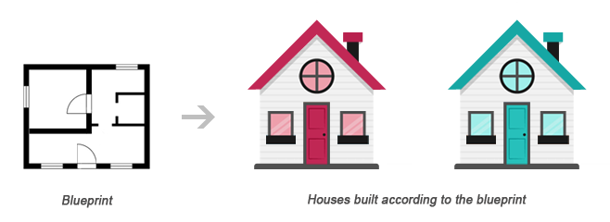
Classes and Objects
Class
Object1
Object2
Class is a blueprint of an object
Object is instance of class
Class describes the object

Slide 17

What is Object-Orientation?

Slide 18
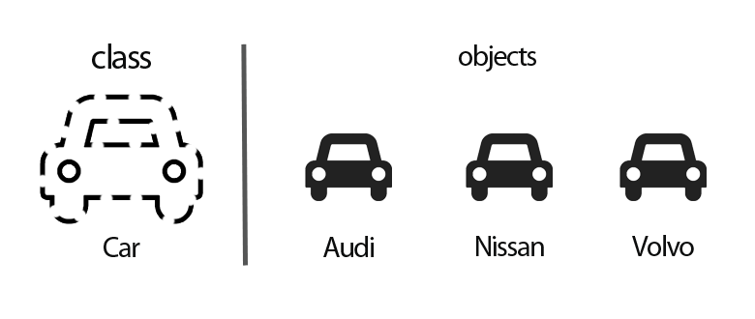
What is Object-Orientation?
Object-oriented modeling and design is a way of thinking about problems using models organized around real-world concepts.
The fundamental construct is object, which combine data structure and behavior.
Object-Oriented Models are useful for
Understanding problems
Communicating with application experts
Modeling enterprises
Preparing documentation
Designing System

Slide 19

Object-Orientated Languages

Slide 20















Object-Orientated Languages

Slide 21
Object-Oriented vs. Procedure-Oriented

Slide 22
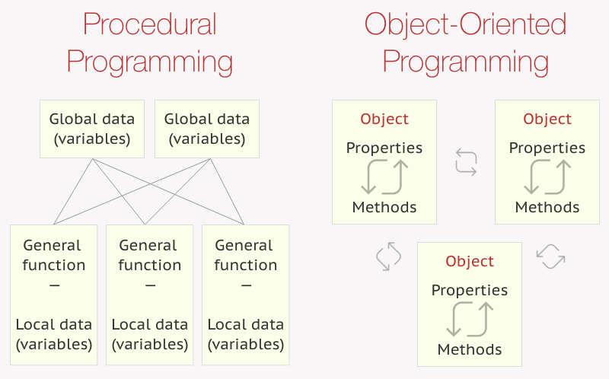
Object-Oriented vs Procedure-Oriented Language

Slide 23
Procedural Programming v/s Object Oriented Programming
Procedural Programming | Object Oriented Programming
Program is divided into functions | Program is divided into classes & objects
The emphasis is on doing things | The emphasis is on data
Poor modeling to real world problems | Strong modeling to real world problems
Difficult to maintain large projects | Easy to maintain large projects
Poor data security | Strong data security
Code can’t be reused in another project | Code can be reused across the projects
Not extensible | Extensible
Productivity is low | Productivity is high
Don’t provide support for new data types | Provides support to new data types
Don’t provide automatic memory management | Provides automatic memory management
e.g. Pascal, C, Basic, Fortran | e.g. C++, C#, Java

Slide 24
Principles of OOP

Slide 25
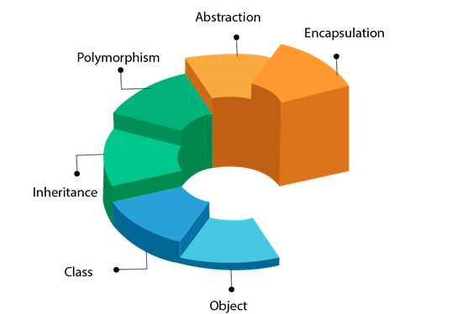
Principles of OOP

Slide 26
Pillars of OOP
Inheritance
Polymorphism
Encapsulation
Abstraction

Slide 27

Inheritance

Slide 28

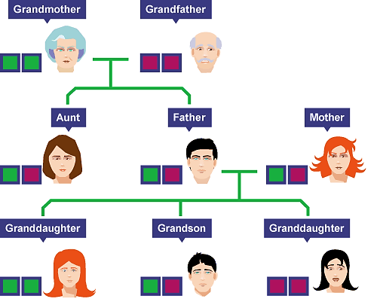
Inheritance

Slide 29
Inheritance
class Doctor
class Footballer
class Businessman
Attributes:
Age, Height, Weight
Methods:
Talk()
Walk()
Eat()
Diagnose()
Attributes:
Age, Height, Weight
Methods:
Talk()
Walk()
Eat()
Playfootball()
Attributes:
Age, Height, Weight
Methods:
Talk()
Walk()
Eat()
Runbusiness()
All of the classes have common attributes (Age, Height, Weight) and methods (Walk, Talk, Eat).
However, they have some special skills like Diagnose, Playfootball and Runbusiness.
In each of the classes, you would be copying the same code for Walk, Talk and Eat for each character.

Slide 30
Inheritance
The mechanism of a class to derive properties and characteristics from another class is called Inheritance.
It is the most important feature of Object Oriented Programming.
Inheritance is the process, by which class can acquire(reuse) the properties and methods of another class.
Base Class: The class whose properties are inherited by sub class is called Base Class/Super class/Parent class.
Derived Class: The class that inherits properties from another class is called Sub class/Derived Class/Child class.
Inheritance is implemented using super class and sub class relationship in object-oriented languages.
Base Class
Derived Class

Slide 31
Inheritance
class Person is called Base class
class Person
Attributes:
Age, Height, Weight
Methods:
Talk() , Walk(), Eat()
class Doctor
class Footballer
class Businessman
Methods:
Diagnose()
Methods:
Playfootball()
Methods:
Runbusiness()
These classes are called Derived class

Slide 32
Inheritance
class Vehicle
Attributes:
Engine_no, color
Methods:
apply_breaks()
class Car
class Bus
class Truck
Attributes:
Private_vehicle
Attributes:
Public_vehicle
Attributes:
Goods_vehicle

Slide 33
Inheritance: Advantages
Promotes reusability
When an existing code is reused, it leads to less development and maintenance costs.
It is used to generate more dominant objects.
Avoids duplicity and data redundancy.
Inheritance makes the sub classes follow a standard interface.
Base Class
Derived Class

Slide 34
Polymorphism

Slide 35

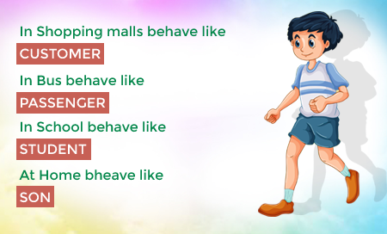



Polymorphism
Polymorphism: It is a Greek term means, “One name many Forms”
Polymorphism
Poly:
Many
Morphism:
Types
Most important concept of object oriented programming
In OOP, Polymorphism is the ability of an object to take on many forms.

Slide 36
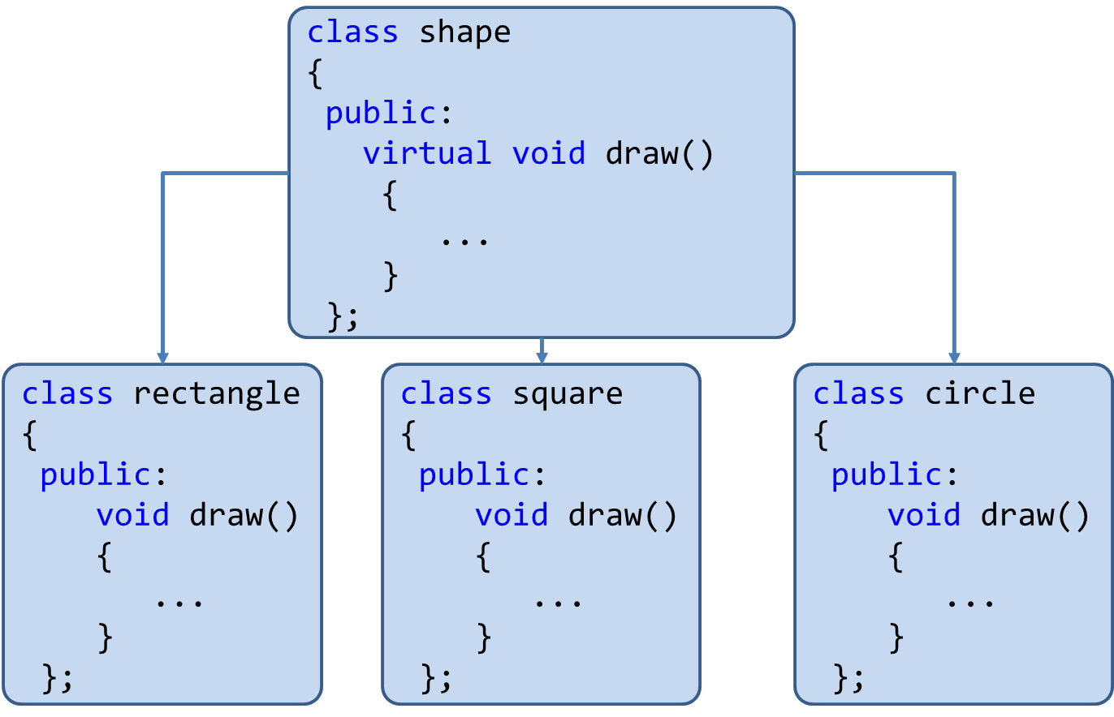
Polymorphism
Polymorphism is the method in an object-oriented programming language that does different things depending on the class of the object which calls it.
Polymorphism can be implemented using the concept of overloading and overriding.

Slide 37
Polymorphism: Advantages
Single variable can be used to store multiple data types.
Easy to debug the codes.
It allows to perform a single act in different ways.
Polymorphism allows the object to decide which form of the function to implement at compile-time (overloading) as well as run-time (overriding).
Reduces coupling, increases reusability and makes code easier to read.

Slide 38
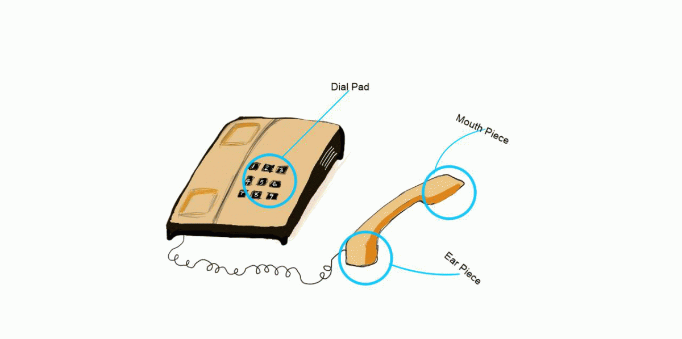
Encapsulation

Slide 39

Encapsulation
Program
Encapsulation
Class
{
Data Members(e.g. int a=10)
+
Methods(e.g. add() )
}
Variables/Data Members
Class
The action of enclosing something in.
In OOP, encapsulation refers to the bundling of data with the methods.
Methods()

Slide 40
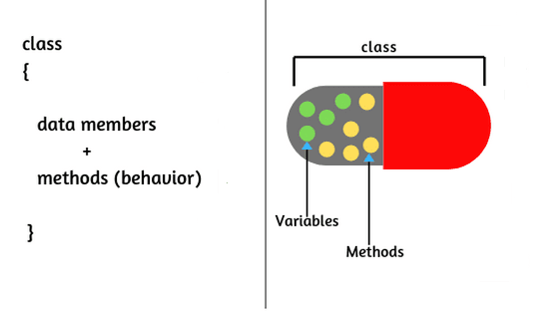
Encapsulation
The wrapping up of data and functions into a single unit is known as encapsulation
The insulation of the data from direct access by the program is called data hiding or information hiding.
It is the process of enclosing one or more details from outside world through access right.
Advantages
Protects an object from unwanted access
It reduces implementation errors.
Simplifies the maintenance of the application and makes the application easy to understand.
Protection of data from accidental corruption.

Slide 41
Abstraction

Slide 42


Abstraction
Data abstraction is also termed as information hiding.
Abstraction is the concept of object-oriented programming that “represents” only essential attributes and “hides” unnecessary information.
Abstraction is all about representing the simplified view and avoid complexity of the system.
It only shows the data which is relevant to the user.
In object-oriented programming, it can be implemented using Abstract Class.
Advantage:
It reduces programming complexity.
Example:
A car is viewed as a car rather than its
numerous individual components.

Slide 43
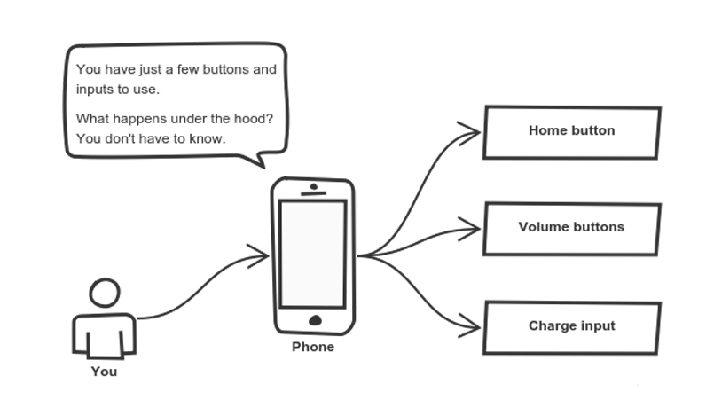
Abstraction

Slide 44
Abstraction vs. Encapsulation

Slide 45
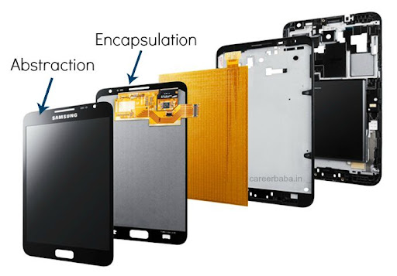
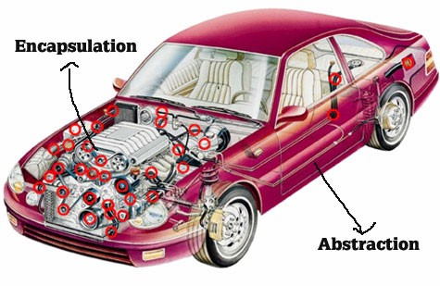
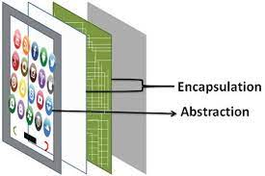
Abstraction vs. Encapsulation
Abstraction | Encapsulation
It means act of removing/ withdrawing something unnecessary. | It is act of binding code and data together and keep the data secure from outside interference.
Applied at Designing stage. | Applied at Implementation stage.
E.g. Interface and Abstract Class | E.g. Access Modifier (public, protected, private)
Purpose: Reduce code complexity | Purpose: Data protection

Slide 46
Advantages of Object-Oriented Programming

Slide 47
Advantages of Object-Oriented Programming
Security
Upgrade-able
Flexibility
High-quality Software
Reusability
Easy Partition
Maintenance
Portability

Slide 48
Applications of Object Oriented Programming

Slide 49





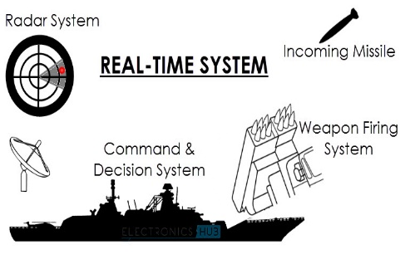
Applications of Object Oriented Programming
User interface design – menu driven application
Real Time Systems
Simulation and Modeling
Object oriented databases
AI and Expert System
Neural Networks and parallel programming
Decision support and office automation systems

Slide 50
Unit-2(Part-II) Class, Object & Methods
Object-Oriented Programming
2105CS102
Prof. Swati R Sharma
Computer Engineering Department
swati.sharma@darshan.ac.in

Slide 51
Classes and Objects

Slide 52
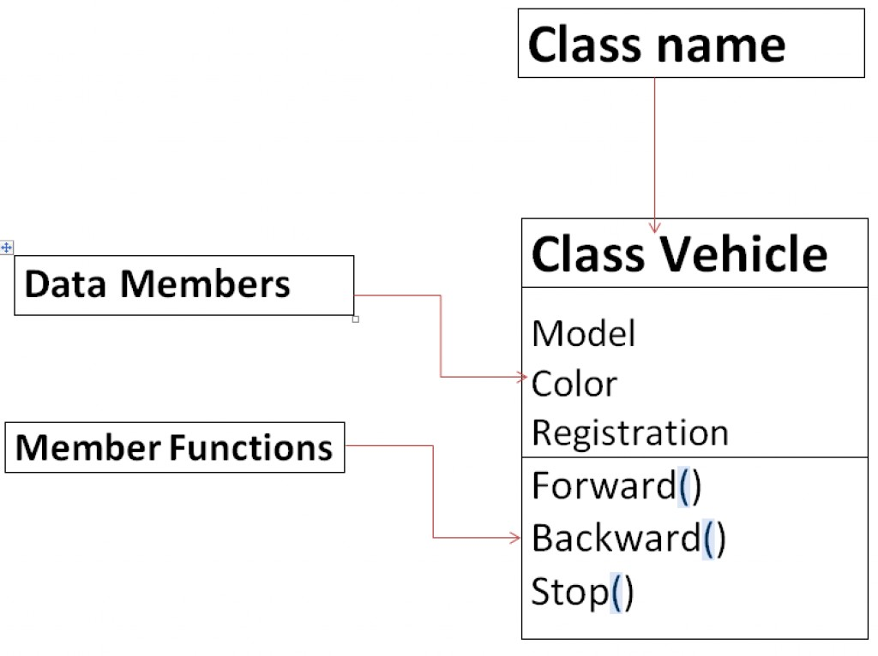
What is Class?
Class can be defined in multiple ways
A class is the building block.
A class is a blueprint for an object.
A class is a user-defined data type.
A class is a collection of objects of the similar kind.
A class is a user-defined data type which combines data and methods.
A class describes both the data and behaviors of objects.
Class contains data members (also known as field or property or data) and member functions (also known as method or action or behavior)
Classes are similar to structures in C.
Class name can be given as per the Identifier Naming Conventions.

Slide 53
What is Object?
Definition: An Object is an instance of a Class.
An Object is a variable of a specific Class
An Object is a data structure that encapsulates data and functions in a single construct.
Object is a basic run-time entity
Objects are analogous to the real-world entities.

Slide 54
Points to Remember
When a class is defined, only the specification or blueprint for the object is defined; no memory or storage is allocated.
When an object of a class is declared, the memory is allocated as per the data members of a class
We can access the data members and member functions of a class by using a . (dot) operator.
Generally Class contains
Data Members
Member Functions
Constructor (Special Member Function)

Slide 55
Class and Objects
Object 1
Person: P1
Name: Narendra Modi
Gender: Male
Age: 71 Years
Profession: Politician
Class
Person
Person: P1
Name
Gender
Age
Profession
Object 2
Person: P2
Person: P2
Name: Amitabh Bachchan
Gender: Male
Age: 79 Years
Profession: Actor

Slide 56
Class and Objects
Object 1
BankAccount: B1
Account_No: 1001123001
balance: 1,00,000
Class
BankAccount: B1
BankAccount
Object 2
Account_No
balance
BankAccount: B2
BankAccount: B2
Account_No: 1001123002
balance: 5,60,0000
BankAccount: B3
Object 3
BankAccount: B3
Account_No: 1001123003
balance: 10,000

Slide 57
Class and Objects
Object 1
Cube : C1
Name:C1
Height:20cm
Width:20cm
Depth:20cm
Class
Cube : C1
Cube
Object 2
Name
Height
Width
Depth
Cube : C2
Name: C2
Height:5cm
Width:5cm
Depth:5cm
Cube : C2
Cube : C3
Object 3
Cube : C3
Name: C3
Height:10cm
Width:10cm
Depth:10cm

Slide 58
Class and Objects
Person
name
employee of
Company
companyName
Class Diagram
*
*
John:Person
name
employee of
IBM:Company
companyName
Parth:Person
name
Object Diagram
Jaya:Person
name
employee
of
TCS:Company
companyName
Amy:Person
name

Slide 59
Class and Objects
Country
countryName
has
CapitalCity
cityName
Class Diagram
1
1
India:Country
countryName
has
NewDelhi:CapitalCity
cityName
Canada:Country
countryName
has
Ottawa:CapitalCity
cityName
Object Diagram
France:Country
countryName
has
Paris:CapitalCity
cityName
Japan:Country
countryName
has
Tokyo:CapitalCity
cityName

Slide 60
Creating Object & Accessing members
new keyword creates new object
Syntax:
ClassName objName = new ClassName();
Example :
SmartPhone iPhone = new SmartPhone();
Object variables and methods can be accessed using the dot (.) operator
Example:
iPhone.storage = 8000;

Slide 61
Declaring an Object
When we create a class, we are creating a new data type.
Object of that data type will have all the attributes and abilities that are designed in the class
MyProg.java
class Square{
double height;
double width;
}
class MyProg{
public static void main(String[] args) {
}
}
NULL
s1
Square s1;
Square s1=new Square();
height
width
s1
The new operator dynamically allocates (that is, allocates at run time) memory for an object and returns a reference to it.
This reference is, more or less, the address in memory of the object allocated by new.
This reference is then stored in the variable. Thus, in Java, all class objects must be dynamically allocated.

Slide 62
Declaring an Object
MyProg.java
class Square{
double height;
double width;
}
class MyProg{
public static void main(String[] args) {
}
}
An object reference is
similar to a memory pointer.
reference
NULL
s1
Square s1; //declare reference to object
s1= new Square();//allocate a Square object
Allocates
Memory
at Runtime
height
width
new operator dynamically allocates memory for an object
Here, s1 is a variable of the class type.
The class name followed by parentheses specifies the constructor for the class.
It is important to understand that new allocates memory for an object during run time.
s1

Slide 63
Assigning Object Reference
ObjectDemo.java
ObjectDemo.java
Rectangle r1=new Rectangle();
Rectangle r2=r1;
Rectangle r1=new Rectangle();
Rectangle r2=r1;
…
R1=null
r1
Width
Height
r1
Width
Height
r2
Here, r1 and r2 will both refer to the same object. The assignment of r1 to r2 did not allocate any memory or copy any part of the original object. It simply makes r2 refer to the same object as does r1.
r2
Here, r1 has been set to null, but r2 still points to the original object.

Slide 64

Implementing Class and Object

Slide 65
WAP using class Person to display name and age
class MyProgram {
public static void main(String[] args) {
Person p1= new Person();
Person p2= new Person();
p1.name="modi";
p1.age=71;
p2.name="bachchan";
p2.age=80;
System.out.println("p1.name="+p1.name);
System.out.println("p2.name="+p2.name);
System.out.println("p1.age="+p1.age);
System.out.println("p2.age="+p2.age);
}//main()
}//class myProgram
class Person
{
String name;
int age;
}//class person
Output
p1.name=modi
p2.name=bachchan
p1.age=71
p2.age=80

Slide 66
WAP using class Person to display name and age with method
class MyProgram {
public static void main(String[] args){
Person p1=new Person();
Person p2=new Person();
p1.name="modi";
p1.age=71;
p2.name="bachchan";
p2.age=80;
p1.displayName();
p2.displayName();
p1.displayAge();
p2.displayAge();
} //main()
} //class myProgram
class Person{
String name;
int age;
public void displayName(){
System.out.println("name="+name);
}
public void displayAge(){
System.out.println("age="+age);
}
}//class person
Output
name=modi
name=bachchan
age=71
age=80

Slide 67
WAP using class Rectangle and calculate area using method
import java.util.*;
class MyProgram {
public static void main(String[] args){
Rectangle r1=new Rectangle();
Scanner sc=new Scanner(System.in);
System.out.print("enter height:");
r1.height=sc.nextFloat();
System.out.print("enter width:");
r1.width=sc.nextFloat();
r1.calArea();
} //main()
}//class myProgram
class Rectangle{
float height;
float width;
public void calArea() {
System.out.println( "Area="+height*width);
} //calArea()
} //class
Output
enter height:30.55
enter width:20.44
Area=624.442

Slide 68
WAP using class Rectangle and calculate area with Return value
import java.util.*;
class MyProgram {
public static void main(String[] args){
float area;
Rectangle r1=new Rectangle();
Scanner sc=new Scanner(System.in);
System.out.print("enter height:");
r1.height=sc.nextFloat();
System.out.print("enter width:");
r1.width=sc.nextFloat();
area=r1.calArea();
System.out.println(“Area="+area);
}//main()
}//class myProgram
class Rectangle{
float height;
float width;
public float calArea() {
return height*width;
}//calArea()
}//class
Output
enter height:30.55
enter width:20.44
Area=624.442

Slide 69
WAP using class Cube and calculate area using method with parameter
import java.util.*;
class MyProgramCube {
public static void main
(String[] args){
float area;
Cube c1= new Cube();
area=c1.calArea(10,10,10);
System.out.println("area="+area);
}//main()
}//class myProgram
class Cube{
float height;
float width;
float depth;
float calArea(float h, float w, float d)
{ height=h;
width=w;
depth=d;
return height*width*depth;
}//calArea()
}//class
10
10
Output
10
area=1000.0

Slide 70
WAP using class Cube and calculate area of two objects
import java.util.*;
class MyProgramCube {
public static void main
(String[] args){
float area;
Cube c1= new Cube(); //Obj1
Cube c2= new Cube(); //Obj2
System.out.println(“c1 area=“ +c1.calArea(10,10,10));
System.out.println(“c2 area=“ +c2.calArea(20,20,20));
} //main()
} //class
class Cube{
float height;
float width;
float depth;
float calArea(float h, float w, float d)
{ height=h;
width=w;
depth=d;
return height*width*depth;
} //calArea()
} //class
20
20
Output
10
10
c1 area=1000.0
c2 area=8000.0
20
10

Slide 71
class Box {
double length;
double breadth;
double height;
}
class BoxDemo {
public static void main(String args[]) {
Box myBox1 = new Box();
Box myBox2 = new Box();
double vol;
myBox1.length = 10;
myBox1.breadth = 20;
myBox1.height = 30;
myBox2.length = 3;
myBox2.breadth = 6;
myBox2.height = 9;
vol = myBox1.length * myBox1.breadth * myBox1.height;
System.out.println("Volume is " + vol);
vol = myBox2.length * myBox2.breadth * myBox2.height;
System.out.println("Volume is " + vol);
}
}
length = 10
length
myBox1
breadth = 20
breadth
height = 30
height
length
length = 3
myBox2
breadth = 6
breadth
height = 9
height

Slide 72
Class vs. Object
Class | Object
Class is a Blueprint or template. | Object is the instance of a class.
Class creates a logical framework that defines the relationship between its members. | When you declare an object of a class, you are creating an instance of that class.
Class is a logical construct. | An object has physical reality. (i.e., an object occupies space in memory.)
Class is a group or collection of similar object. e.g. Car | An Object is defined as real-world entity e.g.:Audi, Volkswagen, Tesla, Ferrari etc.
Class is declared only once | An Object can be created as many times as required
Class doesn’t allocate memory when it is created. | An Object allocates the memory upon creation
Class can exist without its objects. | An Object can’t exist without a class.
Class: Profession Class: Mobile Class: Subject Class: Student Class: Color | Object: Doctor, Teacher, Lawyer, Politician… Object: iPhone, Samsumg, 1plus… Object: Maths, English, Science, Computer… Object: John, Aarav, Smita… Object: Blue, Green, Red, Yellow, Violet, Black…

Slide 73
What is Method?

Slide 74
What is Method?
A method is a group of statements that performs a specific task.
A large program can be divided into the basic building blocks known as method/function.
The function contains the set of programming statements enclosed by { }.
Program execution in many programming language starts from the main function.
main is also a method/function.
void main()
{
// body part
}

Slide 75
Types of Function
Function
Library Function
User Defined Function (UDF)
Predefined or declared inside header files
nextInt() – util library
pow() – math library
Created by User
CalculateSimpleInterest()
CalculateAreaOfCircle()

Slide 76
Program Structure of Function
User-defined function’s program structure is divided into three parts as follows:
C:Function Structure
Java:Function for addition of 2 numbers
void func1();
void main()
{
....
func1();
}
void func1()
{
....
//function body
....
}
Function Prototype
class MethodDemo{
public static void main(String[] ags){
int a=10,b=20,c;
c=add(a,b);
System.out.println("a+b="+c);
}
static int add(int i, int j){
return i+j;
}
}
Function call
Function definition

Slide 77
Method Definition
A method definition defines the method header and body.
A method body part defines method logic.
Method statements
Syntax
Example
return-type method_name(datatyp1 arg1, datatype2 arg2, …)
{
functions statements
}
int addition(int a, int b);
{
return a+b;
}

Slide 78
WAP to add two number using add(int, int) Function
class MethodDemo{
public static void main(String[] args) {
int a=10,b=20,c;
MethodDemo md=new MethodDemo();
c=md.add(a,b);
System.out.println("a+b="+c);
}//main()
int add(int i, int j){
return i+j;
}
}
Output:
a+b=30

Slide 79
Actual parameters v/s Formal parameters
Values that are passed from the calling functions are known actual parameters.
The variables declared in the function prototype or definition are known as formal parameters.
Name of formal parameters can be same or different from actual parameters.
Sequence of parameter is important, not name.
Actual Parameters
Formal Parameters
int a=10,b=20,c;
MethodDemo md=new MethodDemo();
c=md.add(a,b);
// a and b are the actual parameters.
int add(int i, int j)
{
return i+j;
}
// i and j are the formal parameters.

Slide 80
Return Statement
The function can return only one value.
Function cannot return more than one value.
If function is not returning any value then return type should be void.
Main Program
Method
int a=10,b=20,c;
MethodDemo md=new MethodDemo();
c=md.sub(a,b);
// a and b are the actual parameters.
int sub(int i, int j)
{
return i – j;
}
// i and j are the formal parameters.

Slide 81
WAP to calculate the Power of a Number using method
import java.util.*;
public class PowerMethDemo1{
public static void main(String[] args){
int num, pow, res;
Scanner sc=new Scanner(System.in);
System.out.print("enter num:");
num=sc.nextInt();
System.out.print("enter pow:");
pow=sc.nextInt();
PowerMethDemo1 pmd=new PowerMethDemo1();
res = pmd.power(num, pow);
System.out.print("ans="+res);
} //main()
int power(int a, int b){
int i, r = 1;
for(i=1; i<=b; i++)
{
r = r * a;
}
return r;
}//power()
}//class
Output:
enter num:5
enter pow:3
ans=125

Slide 82
Types of Methods(Method Categories)
Functions can be divided in 4 categories based on arguments and return value.
Method without arguments and without return value void add();
Method without arguments and with return value int add();
Method with arguments and without return value void add(int, int);
Method with arguments and with return value int add(int, int);

Slide 83
Method without arguments and without return value
main()
{
add();
}
No Arguments
void add()
{
S.O.P(5+10);
}
No Return Value

Slide 84
Method without arguments and with return value
main()
{
int a;
a = add();
}
int add()
{
return 5+10;
}
No Arguments
With Return Value

Slide 85
Method with arguments and without return value
main()
{
int a=5,b=10;
add(a,b);
}
void add(int a, int b)
{
S.O.P(a+b);
}
With Arguments
No Return Value

Slide 86
Method with arguments and with return value
main()
{
int a=5,b=10,c;
c=add(a,b);
}
int add(int a, int b)
{
return a + b;
}
With Arguments
With Return Value

Slide 87
Method Overloading

Slide 88
Method Overloading: Compile-time Polymorphism
Definition: When two or more methods are implemented that share same name but different parameter(s), the methods are said to be overloaded, and the process is referred to as method overloading
Method overloading is one of the ways that Java implements polymorphism.
When an overloaded method is invoked, Java uses the type and/or number of arguments as its guide to determine which version of the overloaded method to actually call.
E.g. public void draw()
public void draw(int height, int width)
public void draw(int radius)
Thus, overloaded methods must differ in the type and/or number of their parameters.
While in overloaded methods with different return types and same name & parameter are not allowed ,as the return type alone is insufficient for the compiler to distinguish two versions of a method.

Slide 89
Method Overloading: Compile-time Polymorphism
class OverloadDemo{
public static void main(String[] args){
Addition a1= new Addition();
//call all versions of add()
a1.add(20);
a1.add(30,50);
a1.add(10,30,60);
}
}
class Addition{
int i,j,k;
void add(int a){
i=a;
System.out.println("add i="+i);
}
void add(int a,int b){\\overloaded add()
i=a;
j=b;
System.out.println("add i+j="+(i+j));
}
void add(int a,int b,int c){\\overloaded add()
i=a;
j=b;
k=c;
System.out.println("add i+j+k="+(i+j+k));
}
}
Output
add i=20
add i+j=80
add i+j+k=100

Slide 90
Method Overloading: Compile-time Polymorphism
class OverloadDemo{
public static void main(String[] args){
Addition a1= new Addition();
//call all versions of add()
a1.add(20);
a1.add(30,50);
a1.add(10,30,60);
a1.add(30.5,50.67);
}
}
class Addition{
int i,j,k;
void add(int a){
i=a;
System.out.println("add i="+i);
}
void add(int a,int b){\\overloaded add()
i=a;
j=b;
System.out.println("add i+j="+(i+j));
}
void add(double a, double b){\\overloaded add()
System.out.println("add a+b="+(a+b));
}
void add(int a,int b,int c){\\overloaded add()
i=a;
j=b;
k=c;
System.out.println("add i+j+k="+(i+j+k));
}
}
Output
add i=20
add i+j=80
add i+j+k=100
add a+b=81.17

Slide 91
Method Overloading: Points to remember
Method overloading supports polymorphism because it is one way that Java implements the “one interface, multiple methods” paradigm.
Overloading increases the readability of the program.
There are two ways to overload the method in java
By changing number of arguments
By changing the data type
In java, method overloading is not possible by changing the return type of the method only because of ambiguity.

Slide 92
Method Overloading: Points to remember
Can we overload java main() method?
Yes, by method overloading. We can have any number of main methods in a class by method overloading
But JVM calls main() method which receives string array as arguments only.

Slide 93
Advantages of Method
Reduced Code Redundancy
Rewriting the same logic or code again and again in a program can be avoided.
Reusability of Code
Same function can be call from multiple times without rewriting code.
Reduction in size of program
Instead of writing many lines, just function need to be called.
Saves Development Time
Instead of changing code multiple times, code in a function need to be changed.
More Traceability of Code
Large program can be easily understood or traced when it is divide into functions.
Easy to Test & Debug
Testing and debugging of code for errors can be done easily in individual function.

Slide 94

Constructor

Slide 95
Constructor
A constructor in Java is a special type of method that is used to initialize objects.
The constructor is called when an object of a class is created.
A constructor initializes an object immediately upon creation.
It has the same name as the class in which it resides and is syntactically similar to a method.
JVM first allocates the memory for variables (objects) and then executes the constructor to initialize instance variables.
The JVM calls it automatically when we create an object.
A constructor defines what happens when an object of a class is created.
class Cube{
instance variable1
instance variable1
…
Cube()
{
//initailze object }
} //class

Slide 96
Properties of Constructor
Constructor is invoked automatically whenever an object of class is created.
Constructors do not have return types and they cannot return values, not even void.
All classes have constructors by default: if you do not create a class constructor yourself, Java creates one for you known as default constructor.
Constructor is a method that is called at runtime during the object creation by using the new operator. The JVM calls it automatically when we create an object.
It is called and executed only once per object.
It means that when an object of a class is created, constructor is called. When we create 2nd object then the constructor is again called during the second time.
class Demo{
instance variable1
instance variable1
…
Demo()
{
//initailze object }
} //class

Slide 97
Types of Constructor
Constructor
Default
No-Argument
Parameterized
Copy Constructor

Slide 98
Default Constructor

Slide 99

Default Constructor: MyConst.java
class MyConst {
public static void main(String[] args) {
MyConst c=new MyConst();
}
}
Compiler
After Compilation
class MyConst{
MyConst(){
//Default Constructor…
}
public static void main(String[] args) {
c=new MyConst();
}
}

Slide 100
Default Constructor
Once you define your own constructor, the default constructor is no longer used.
The default constructor automatically initializes all instance variables to zero.
Example:
class MyAccount{
int accNo;
double balance;
MyAccount(){
//default constructor
}
}//class
class MyBank {
public static void main(String[] args){
MyAccount ma= new MyAccount();
System.out.println("balance="+ma.balance);
}//main()
}//class
Output
balance=0.0

Slide 101
No-Argument Constructor

Slide 102
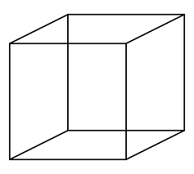
No-Argument Constructor: MyMain.java
class Cube {
double width;
double height;
double depth;
Cube()
{
System.out.println(" Constructing cube");
width = 10;
height = 10;
depth = 10;
}//Cube()
}//class
class MyMain{
public static void main(String[] args){
Cube c=new Cube();
}
}
If you implement any constructor then you no longer receive a default constructor from Java compiler.

Slide 103
Parameterized Constructor

Slide 104
Parameterized Constructor: MyMain.java
class Cube {
double width, height, depth;
Cube(double w, double h, double d)
{ System.out.println(" Constructing cube");
width = w;
height = h;
depth = d;
}//Cube()
}//class
class MyMain{
public static void main(String[] args){
Cube c=new Cube(10,10,10);
}
}

Slide 105
Parameterized Constructor: MyMain.java with method
class Cube {
double width,height,depth;
Cube(double w, double h, double d)
{ System.out.println("Constructing cube");
width = w;
height = h;
depth = d;
}//cube()
void calVolume(){
System.out.println("Volume=" +width*height*depth);
} //calVolume()
} //class
class MyMain{
public static void main(String[] args){
Cube c=new Cube(10,10,10);
c.calVolume();
}
}

Slide 106
Parameterized Constructor: method with return value
class Cube {
double width,height,depth;
Cube(double w, double h, double d)
{ System.out.println("Constructing cube");
width = w;
height = h;
depth = d;
}//cube()
double calVolume(){
return width*height*depth;
}//calVolume()
}//class
class MyMain{
public static void main(String[] args){
double vol;
Cube c=new Cube(10,10,10);
vol=c.calVolume();
System.out.println(" Volume="+vol);
}
}
Output
Constructing cube
Volume=1000.0

Slide 107

‘this’ keyword
this

Slide 108
class Box {
double length;
double breadth;
double height;
Box(double l, double b, double h) {
System.out.println("Constructing Box");
length = l;
breadth = b;
height = h;
}
void volume() {
double volume = length * breadth * height;
System.out.println("Volume is " + volume);
}
}
class BoxDemo {
public static void main(String args[]) {
Box myBox1 = new Box(10,20,30);
Box myBox2 = new Box(3,6,9);
myBox1.volume();
myBox2.volume();
}
}
Box(double length, double breadth, double height) {
this.length = length;
this.breadth = breadth;
this.height = height;
length = length;
breadth = breadth;
height = height;
Creates ambiguity for compiler
length is instance variable as well as length is formal parameter of method

Slide 109
‘this’ Keyword
this is a reference variable that refers to the current object.
this can be used to invoke current object's method.
this() can be used to invoke current class constructor
this can be passed as a parameter to constructor and method call.
this can be used to return the current object from the method.
This

Slide 110

Copy Constructor

Slide 111
Copy Constructor
It is a special type of constructor that is used to create a new object using the existing object of a class that had been created previously.
It creates a new object by initializing the object with the instance of the same class.
Constructor 1()
{
…
}
Constructor 2(Constructor 1)
{
…
}
Copy Constructor

Slide 112
Copy Constructor: MyProgramCopy.java
class Student{
String name;
int rollno;
Student(String s_name, int s_roll){
System.out.println("ConstructorInvoked");
this.name=s_name;
this.rollno=s_roll;
} //Constructor1
Student(Student s){ //CopyConstructor
System.out.println("CopyConstructor Invoked");
this.name=s.name;
this.rollno=s.rollno;
} //Constructor2
public void display(){
System.out.print("name="+name);
System.out.println(" rollno="+rollno);
} // display()
} //class
class MyProgramCopy {
public static void main(String[] args){
Student s1=new Student("darshan",101);
//invoking Copy Constructor
Student s2=new Student(s1);
s1.display();
s2.display();
} //main()
} //class myProgram
Output
Constructor Invoked
CopyConstructor Invoked
name=darshan rollno=101
name=darshan rollno=101

Slide 113
Advantages of Copy Constructor
It is easier to use when our class contains a complex object with various parameters.
Whenever we need to add all the field of a class to another object, then just send the reference of previously created object.
One of the most importance of copy constructors is that there is no need for any typecasting.
Using a copy constructor, we can have complete control over object creation.
With Copy Constructor, we can pass object of the class as a parameter(pass by reference).
Constructor 1()
{
…
}
Constructor 2(Constructor 1)
{
…
}
Copy Constructor

Slide 114
Constructor Overloading

Slide 115
Constructor Overloading
In addition to overloading normal methods, you can also overload constructor methods.
class Balance{
int accNo;
double bal;
Balance(){
System.out.println("inside const1");
bal=0;
}
Balance(double b){
System.out.println("inside const2");
bal=b;
}
Balance(int a,double b){
System.out.println("inside const3");
bal=b;
accNo=a;
}
}
class Account{
public static void main(String args[]){
Balance b1= new Balance();
Balance b2= new Balance(100);
Balance b3=new Balance(1201,10000);
System.out.println("b1.bal="+b1.bal);
System.out.println("b2.bal="+b2.bal);
System.out.println("b3.bal="+b3.bal+ "b3.accNo="+b3.accNo);
}
}

Slide 116

Why Constructor?
The pivotal purpose of constructor is to initialize the instance variable of the class.
We use constructors to initialize the object with the default or initial state.
Through constructor, we can request the user of that class for required dependencies.
A constructor within a class allows constructing the object of the class at runtime.
Allocates appropriate memory to objects.
If we need to execute some code at the time of object creation, we can write them inside the constructor.
Example:
If we talk about a Cube class then class variables are width, height and depth.
But when it comes to creating its object(i.e Cube will now exist in the computer’s memory), then can a cube be there with no value defined for its dimensions? The answer is “NO”.
So constructors are used to assign values to the class variables at the time of object creation.

Slide 117

When to use Constructor?
When we need to execute some code at the time of object creation.
Used for the initialization of instance variables.
To assign the default value to instance variables.
To initializing objects of the class.

Slide 118
Constructor() vs. Method()
 | Constructor() | Method()
Naming | Constructor name must be same as class name. | Method name can be anything.
Return types | Constructor does not have any return type, not even void. | Method must have return types, at least void.
Call | Constructor can be invoked implicitly when object is created. | Method is called by the programmer. Invoked explicitly.
Purpose | To initialize an object | To execute the code
Inheritance | Constructor cannot be inherited by subclass. | Method can be inherited by subclass.

Slide 119
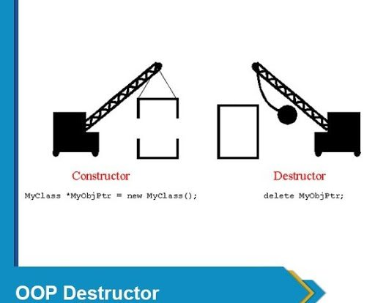
Destructor

Slide 120
Destructor
Destructor is the opposite to the constructor. Constructor is used to initialize objects while the destructor is used to delete or destroy the object that releases the resource occupied by the object.
Definition: Destructor is an instance member function which is invoked automatically whenever an object is going to be destroyed.
In other words, a destructor is the last function that is going to be called before an object is destroyed.
In java, there is a special method named garbage collector that automatically called when an object is no longer used.
When an object completes its life-cycle the garbage collector deletes that object and de-allocates or releases the memory occupied by the object.
In C++, dynamically allocated objects must be manually released by use of a delete operator.
Java takes a different approach: it handles de-allocation automatically.
The technique that accomplishes this is known as “garbage collection”.

Slide 121
Destructor
Why Destructor?
When we create an object of the class(using new), it occupies some space in the memory. If we do not delete these objects, it remains in the memory and occupies unnecessary space.
To resolve this problem, we use the destructor.
Remember that there is no concept of destructor in Java.
Instead of destructor, Java provides the garbage collector that works the same as the destructor.
The garbage collector is a program (thread) that runs on the JVM. It automatically deletes the unused objects (objects that are no longer used) and free-up the memory.
The programmer has no need to manage memory, manually.

Slide 122
Working of garbage collector(destructor) in java
When the object is created it occupies the space in the heap. These objects are used by the threads.
If the objects are no longer used by the thread it becomes eligible for the garbage collection.
The memory occupied by that object is now available for new objects that are being created.
When the garbage collector destroys an object, the JRE calls finalize() method to close the connections such as database and network connection.

Slide 123
Static

Slide 124
Static in java
Static in Java
Static Variable
Static Method
Static Block
Static Class

Slide 125
Static
The static keyword is used for memory management.
We can apply static keyword with variables, methods, blocks and nested classes.
The static keyword belongs to the class than an instance of the class.
The static can be:
Variable (also known as a class variable)
Method (also known as a class method)
Block
Nested class

Slide 126
Static Variable
Static variables have a property of preserving their value even after they are out of their scope.
The static variable gets memory only once in the class area at the time of class loading.
Advantage of static variable: It makes program memory efficient (static variable saves memory).
Characteristics of static variable:
It is initialized to zero when the first object of its class is created. No other initialization is allowed.
Only one copy of that member is created for the entire class and is shared by all the objects of that class, no matter how many objects are created.
It is visible only within the class, but its lifetime is the entire program.
Static variables are normally used to maintain values common for all objects.
The class constructor does not initialize static variable.

Slide 127
Static vs Non-Static Function
MyProgram.java(Non-static function)
MyProgram.java(static function)
public class MyProgram { public static void main(String[] args) { int a=1,b=2,c; MyProgram mp=new MyProgram(); c = mp.add(a,b); System.out.println(c); }//main public int add(int i,int j) { return i + j; } }//class
public class MyProgram { public static void main(String[] args) { int a=1,b=2,c; c = add(a,b); System.out.println(c); }//main static int add(int i,int j) { return i + j; } }//class

Slide 128
Characteristic of static method
A static method can call only other static methods and can not call a non-static method from it.
A static method can be accessed directly by the class name and doesn’t need any object
A static method cannot refer to “this” or “super” keywords.

Slide 129
Static Method: WAP using class Rectangle and calculate area
import java.util.*;
class Rectangle{
static float height;
static float width;
static void calArea() {
System.out.println( "Area= " +height*width);
} //calArea()
} //class
class MyRectangle {
public static void main(String[] args){
Rectangle r1= new Rectangle();
Scanner sc= new Scanner(System.in);
System.out.print("enter height:");
r1.height=sc.nextFloat();
System.out.print("enter width:");
r1.width=sc.nextFloat();
Rectangle.calArea();
} //main()
} //class
Output
enter height:30.55
enter width:20.44
Area=624.442

Slide 130
static keyword
static keyword is mainly used for memory management.
It can be used with
Variables
Methods
Blocks
Nested classes
Basically, static is used for a constant variable or a method that is same for every instance of a class.
The static variable can be used to refer to the common property of all objects.
The static variable gets memory only once in the class area at the time of class loading.
It makes your program memory efficient.
Syntax
static type variablename;

Slide 131
class Student {
int rollNo;
String name;
.
.
.
}
static String college = "DIET";
String college = "DIET";
class StudentDemo {
public static void main(String args[]) {
Student student1 = new Student();
Student student2 = new Student();
Student student3 = new Student();
.
.
.
}
}
student1
student2
student3
rollNo
name
college
DIET
DIET
DIET
college
DIET

Slide 132
static method
If you apply static keyword with any method, it is known as static method.
A static method belongs to the class rather than the object of a class.
A static method can be invoked without the need for creating an instance of a class.
A static method can access static data member and can change the value of it.
Restrictions
The static method cannot use non-static data member or call non-static method directly.
this and super cannot be used in static context.

Slide 133
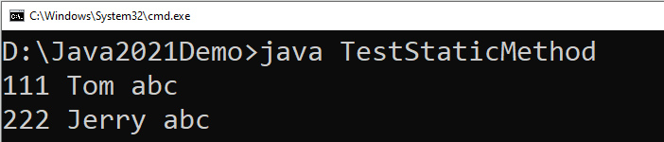
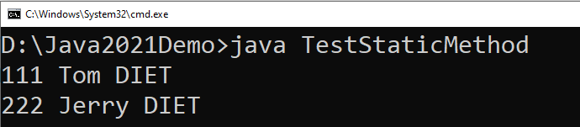
class Student {
int rollno;
String name;
static String college="abc";
static void change() {
college = "DIET";
rollno = 10;
}
Student(int r, String n) {
rollno = r;
name = n;
}
void display() {
System.out.println(rollno+" "+name+" "+college);
}
}
class TestStaticMethod {
public static void main(String args[]) {
Student.change();
Student s1 = new Student(111,"Tom");
Student s2 = new Student(222,"Jerry");
s1.display();
s2.display();
}
}
We can not use non-static variables in static methods

Slide 134
Static Block
Static block is executed exactly once, when the class is first loaded.
It is used to initialize static variables of the class.
It will be executed even before the main() method.
Syntax
How to call static block in java?
Unlike method, there is no specified way to call a static block.
The static block executes automatically when the class is loaded in memory.
static {
//initialisation of static variables…
}

Slide 135
Example: Static Block, Method and Variable
class StaticDemo {
static int a = 4; //static variable declared & initialized
static int b; //static variable declared
static void dispValue(int x) {
System.out.println("Static method initialized.");
System.out.println("x = " + x);
System.out.println("a = " + a);
System.out.println("b = " + b);
} //static method
static {
System.out.println("Static block initialized.");
b= a * 5;
} //static block
public static void main(String args[]) {
System.out.println("inside main()...");
dispValue(44);
} //main()
} //class
3
1
Output
Static block initialized.
inside main()...
Static method initialized.
x = 44
a = 4
b = 20
2

Slide 136
Points to remember for static keyword
When we declare a field static, exactly a single copy of that field is created and shared among all instances of that class.
Static variables belong to a class, we can access them directly using class name. Thus, we don't need any object reference.
We can only declare static variables at the class level.
We can access static fields without object initialization.
Static methods can't be overridden.
Abstract methods can't be static.
Static methods can't use this or super keywords.
Static methods can't access instance variables and instance methods directly. They need some object reference to do so.
A class can have multiple static blocks.

Slide 137
Mutable and Immutable Objects
The content of mutable object can be changed, while content of immutable objects can not be changed.
class MutableClass{
int a;
void add5() {
a = a + 5;
}
}
public class MutableClassDemo {
public static void main(String[] args) {
MutableClass m1 = new MutableClass();
m1.a = 10;
m1.add5();
System.out.println(m1.a);
}
}
class ImmutableClass{
int a;
int add5() {
return ( a + 5 );
}
}
public class MutableClassDemo {
public static void main(String[] args) {
ImmutableClass m1 = new ImmutableClass();
m1.a = 10;
int ans = m1.add5();
System.out.println("A in m1 = " + m1.a);
System.out.println("returned = " + ans);
}
}

Slide 138
Passing Objects as Argument
In order to understand how and why we need to pass object as an argument in methods, lets see the below example.
class Time{
int hour;
int minute;
int second;
public Time(int hour, int minute, int second) {
this.second = second;
this.minute = minute;
this.hour = hour;
}
void add(Time t) {
this.second += t.second;
if(this.second>=60) {
this.minute++;
this.second-=60;
}
this.minute += t.minute;
if(this.minute>=60) {
this.hour++;
this.minute-=60;
}
this.hour += t.hour;
}
}
public class TimeDemo {
public static void main(String[] args) {
Time t1 = new Time(11,59,55);
Time t2 = new Time(0,0,5);
t1.add(t2);
System.out.println(t1.hour + ":" + t1.minute + ":" + t1.second);
}
}

Slide 139
Array of Objects
We can create an array of object in java.
Similar to primitive data type array we can also create and use arrays of derived data types (class).
class Student{
int rollNo;
String name;
public Student(int rollNo, String name) {
this.rollNo = rollNo;
this.name = name;
}
void printStudentDetail() {
System.out.println("| "+
rollNo
+" | -- | "+
name +" |");
}
}
public class ArrayOfObjectDemo {
public static void main(String[] args) {
Student[] stu = new Student[3];
stu[0] = new Student(101,"darshan");
stu[1] = new Student(102, "OOP");
stu[2] = new Student(103,"java");
stu[0].printStudentDetail();
stu[1].printStudentDetail();
stu[2].printStudentDetail();
}
}

Slide 140
Nested Class

Slide 141
Nested Class
Nested Class: Class within another class
Scope: Nested class is bounded by the scope of its enclosing class.
E.g. class B is defined within class A, then B is known to A, but not outside of A.
A nested class has access to the members, including private members of the class in which it is nested.
However, the enclosing class does not have access to the members of the nested class. i.e. Class B can access private member of class A, while reverse is not accessible.
A: Outer Class
B: Nested
Class

Slide 142
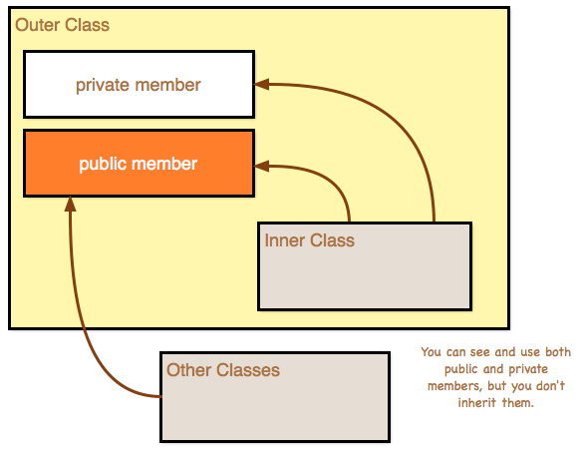
Nested Class

Slide 143
Nested Class
Types of Nested class:
Nested Class
Static
Nested Class
Non- Static
Nested Class

Slide 144
Non-Static Nested Class: InnerOuterDemo.java
class Outer{
private int a=100;//instance variable
void outerMeth(){
Inner i= new Inner();
System.out.println("inside outerMeth()...");
i.innerMeth();
}
class Inner{
int b=20;
void innerMeth(){
System.out.println("inside innerMeth()..."
+(a+b));
}
} //inner class
} //outer class
class InnerOuterDemo{
public static void main(String[] args)
{
Outer o= new Outer();
o.outerMeth();
}
} //InnerOuterDemo
Output
inside outerMeth()...
inside innerMeth()...120

Slide 145
Static Nested Class: InnerOuterDemo
class Outer{
void outerMeth(){
Inner i= new Inner();
System.out.println("inside outerMeth()...");
i.innerMeth();
}
static class Inner{
int b=20;
void innerMeth(){
System.out.println("inside innerMeth()..."
+(a+b));
}
} //inner class
} //outer class
error: non-static variable a cannot be referenced from a static context
static int a=100;
class InnerOuterDemo{
public static void main(String[] args)
{
Outer o= new Outer();
o.outerMeth();
}
} //InnerOuterDemo
int a=100;//instance variable
Output
inside outerMeth()...
inside innerMeth()...120

Slide 146
Points to remember: Inner class
Inner class implements a security mechanism in Java.
Reduces encapsulation, more organized code by logically grouping the classes.
A: Outer Class
B: Nested
Class

Slide 147
Exercise Programs
Write a class named Rectangle to represent a rectangle. It contains following members: Data: width (double) and height (double) that specify the width and height of the rectangle. Methods: 1. A no-arg constructor that creates a default rectangle. 2. A constructor that creates a rectangle with the specified width and height. 3. A method named getArea() that returns the area of this rectangle. 4. A method named getPerimeter() that returns the perimeter.
Write a program to create circle class with area function to find area of circle.
Define time class with hour and minute. Also define addition method to add two time objects.
Declare a class called student having following data members:id_no, no_of_subjects_registered, subject_code, subject_credits, grade_obtained and spi. Define constructor and calculate_spi methods. Define main to instantiate an array for objects of class student to process data of n students.

Slide 148
String Class
An object of the String class represents a string of characters.
The String class belongs to the java.lang package, which does not require an import statement.
Like other classes, String has constructors and methods.
String class has two operators, + and += (used for concatenation).
Empty String :
An empty String has no characters. It’s length is 0.
Not the same as an uninitialized String.
String word1 = "";
String word2 = new String();
Empty strings
This is null
String word1;

Slide 149
String Initialization
Copy constructor creates a copy of an existing String.
Copy Constructor: Each variable points to a different copy of the String.
String word = new String("Java");
String word2 = new String(word);
word
"Java"
word2
"Java"
Assignment: Both variables point to the same String.
String word = "Java";
String word2 = word;
word
"Java"
word2

Slide 150
String Immutability
Advantage
Disadvantage
Convenient — Immutable objects are convenient because several references can point to the same object safely.
Less efficient — you need to create a new string and throw away the old one even for small changes.
String name="DIET - Rajkot";
foo(name);
//Some operations on String name
name.substring(7,13);
bar(name);
/* we will be sure that the value of name will be same for foo() as well as bar() as String is immutable its value will be same for both the functions.
*/
String word = "java";
char ch =
Character.toUpperCase(
word.charAt (0));
word = ch + word.substring (1);
word
"java"
"Java"

Slide 151
String Methods — length, charAt
int length();
Returns the number of characters in the string
Returns:
"Problem".length();
7
char charAt(i);
Returns the char at position i.
Character positions in strings starts from 0 – just like arrays.
Returns:
"Window".charAt (2);
'n'

Slide 152
String Methods — substring
We can obtain a portion of a string by use of substring(), It has two forms
String subs = word.substring (i, k);
returns the substring of chars in positions from i to k-1
String subs = word.substring (i);
returns the substring from the i-th char to the end
television
i k
immutable
i
Returns:
"television".substring(2,5);
"immutable".substring(2);
"rajkot".substring(9);
“lev"
“mutable"
"" (empty string)

Slide 153
String Methods — Concatenation
public class ConcatenationExample{
public static void main(String[] args) {
String word1 = "re";
String word2 = "think";
String word3 = "ing";
int num = 2;
String result = word1 + word2;
// concatenates word1 and word2 "rethink"
result = word1.concat(word2);
// the same as word1 + word2 "rethink"
result += word3;
// concatenates word3 to result "rethinking"
result += num;
// converts num to String & joins it to result "rethinking2"
}
}

Slide 154
String Methods — Find (indexOf)
String name = " ";
name.indexOf ('P');
name.indexOf ('e');
name.indexOf ("Minister");
name.indexOf ('e', 8);
name.indexOf (“xyz");
name.lastIndexOf ('e');
P | r | i | m | e |  | M | i | n | i | s | t | e | r
0 | 1 | 2 | 3 | 4 | 5 | 6 | 7 | 8 | 9 | 10 | 11 | 12 | 13
0
4
6
12
(starts searching at position 8)
-1
(not found)
12

Slide 155
String Methods — Equality
boolean b = word1.equals(word2);
returns true if the string word1 is equal to word2
boolean b = word1.equalsIgnoreCase(word2);
returns true if the string word1 matches word2, ignoring the case of the string.
b = "Raiders".equals("Raiders"); // will return true
b = "Raiders".equals("raiders"); // will return false
b = "Raiders".equalsIgnoreCase("raiders"); // will return true

Slide 156
String Methods — Comparisons
int diff = word1.compareTo(word2);
returns the “difference” word1 - word2
int diff = word1.compareToIgnoreCase(word2);
returns the “difference” word1 - word2, ignoring the case of the strings
Usually programmers don’t care what the numerical “difference” of word1 - word2 is, what matters is if
the difference is negative (word1 less than word2),
zero (word1 and word2 are equal)
or positive (word1 grater than word2).
Often used in conditional statements.
if(word1.compareTo(word2) > 0){
//word1 grater than word2…
}

Slide 157
Comparison Examples
//negative differences
diff = "apple".compareTo("berry"); // a less than b
diff = "Zebra".compareTo("apple"); // Z less than a
diff = "dig".compareTo("dug"); // i less than u
diff = "dig".compareTo("digs"); // dig is shorter
//zero differences
diff = "apple".compareTo("apple"); // equal
diff = "dig".compareToIgnoreCase("DIG"); // equal
//positive differences
diff = "berry".compareTo("apple"); // b grater than a
diff = "apple".compareTo("Apple"); // a grater than A
diff = "BIT".compareTo("BIG"); // T grater than G
diff = "application".compareTo("app"); // application is longer

Slide 158
String Methods — trim & replace
trim() method
replace() method
String word2 = word1.trim();
returns a new string formed from word1 by removing white space at both ends,
it does not affect whites space in the middle.
String word2 = word1.replace(oldCh, newCh);
returns a new string formed from word1 by replacing all occurrences of oldCh with newCh
String word1 = " Hello From Darshan ";
String word2 = word1.trim();
// word2 is "Hello From Darshan"
// no spaces on either end
String word1 = "late";
String word2 = word1.replace('l', 'h');
System.out.println(word2);
//Output : "hate"
String str1 = "Hello World";
String str2; str2=str1.replace("World","Everyone");
System.out.println(str2);
// Output : "Hello Everyone"

Slide 159
String Methods — Changing Case
String word2 = word1.toUpperCase();
returns a new string formed from word1 by converting its characters to upper case
String word3 = word1.toLowerCase();
returns a new string formed from word1 by converting its characters to lower case
String word1 = "HeLLo";
String word2 = word1.toUpperCase(); // "HELLO"
String word3 = word1.toLowerCase(); // "hello"

Slide 160
StringBuffer
The java.lang.StringBuffer class is a thread-safe, mutable sequence of characters.
Following are the important points about StringBuffer:
A string buffer is like a String, but can be modified (mutable).
It contains some particular sequence of characters, but the length and content of the sequence can be changed through certain method calls.
They are safe for use by multiple threads.
StringBuffer Constructors
S.N | Constructor & Description
1 | StringBuffer() This constructs a string buffer with no characters in it and an initial capacity of 16 characters.
2 | StringBuffer(CharSequence seq) This constructs a string buffer that contains the same characters as the specified CharSequence.
3 | StringBuffer(int capacity) This constructs a string buffer with no characters in it and the specified initial capacity.
4 | StringBuffer(String str) This constructs a string buffer initialized to the contents of the specified string.

Slide 161
StringBuffer Methods
Remember : “StringBuffer” is mutable
As StringBuffer class is mutable we need not to replace the reference with a new reference as we have to do it with String class.
Method | description
append(String s) | is used to append the specified string with this string.
insert(int offset, String s) | is used to insert the specified string with this string at the specified position.
replace(int startIndex, int endIndex, String str) | is used to replace the string from specified startIndex and endIndex.
delete(int startIndex, int endIndex) | is used to delete the string from specified startIndex and endIndex.
reverse() | is used to reverse the string.
StringBuffer str1 = new StringBuffer("Hello Everyone");
str1.reverse();
// as it is mutable can not write str1 = str1.reverse();
// it will change to value of the string itself
System.out.println(str1);
// Output will be “enoyrevE olleH”

Slide 162
String Builder
Java StringBuilder class is used to create mutable string.
The Java StringBuilder class is same as StringBuffer class except that it is non-synchronized.
It is available since JDK 1.5.
It has similar methods as StringBuffer like append, insert, reverse etc…

Slide 163

Mathematical functions

Slide 164
Math class
The Java Math class provides more advanced mathematical calculations other than arithmetic operator.
The java.lang.Math class contains methods which performs basic numeric operations such as the elementary exponential, logarithm, square root, and trigonometric functions.
All the methods of class Math are static.
Fields :
Math class comes with two important static fields
E : returns double value of Euler's number (i.e 2.718281828459045).
PI : returns double value of PI (i.e. 3.141592653589793).

Slide 165
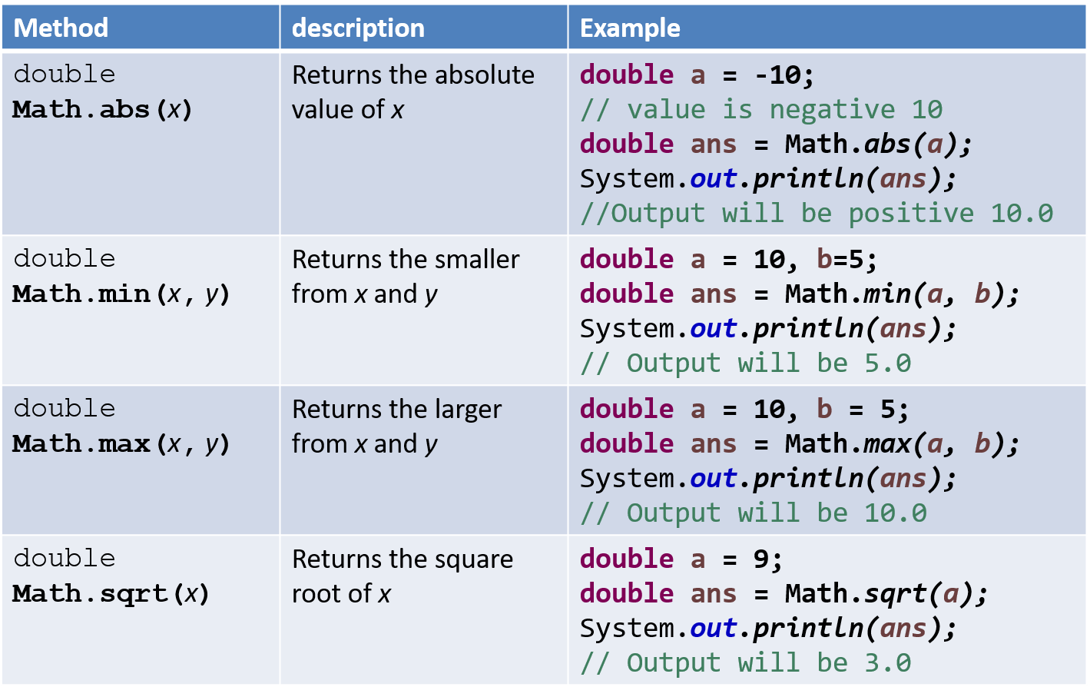
Methods of class Math

Slide 166
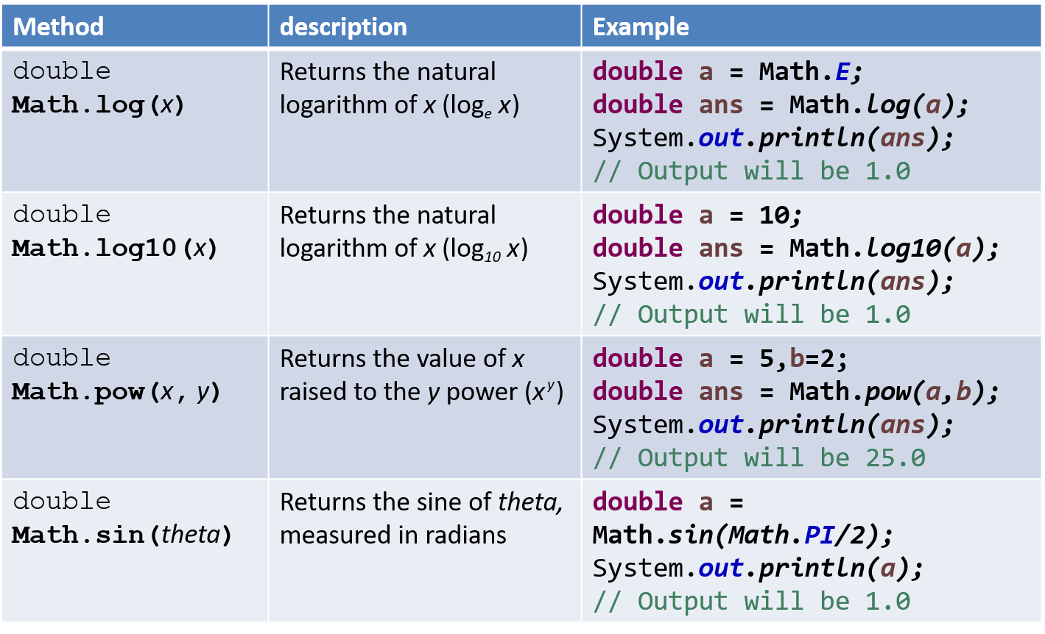
Methods of class Math (Cont.)

Slide 167
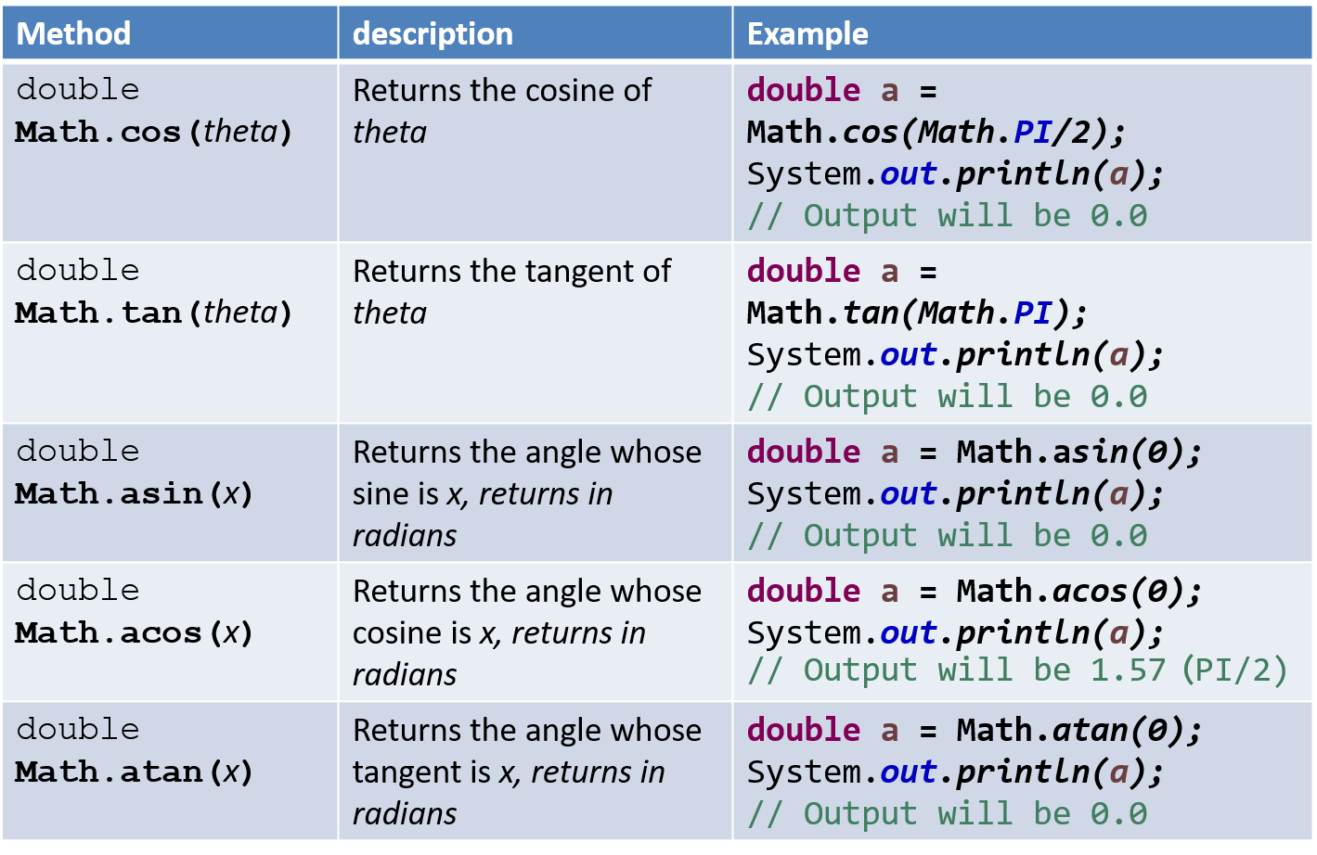
Methods of class Math (Cont.)

Slide 168
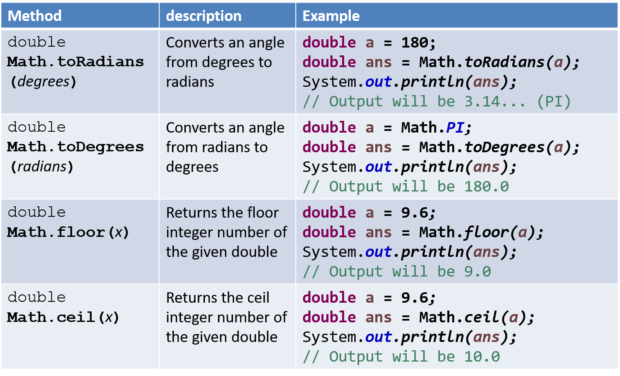
Methods of class Math (Cont.)

Slide 169
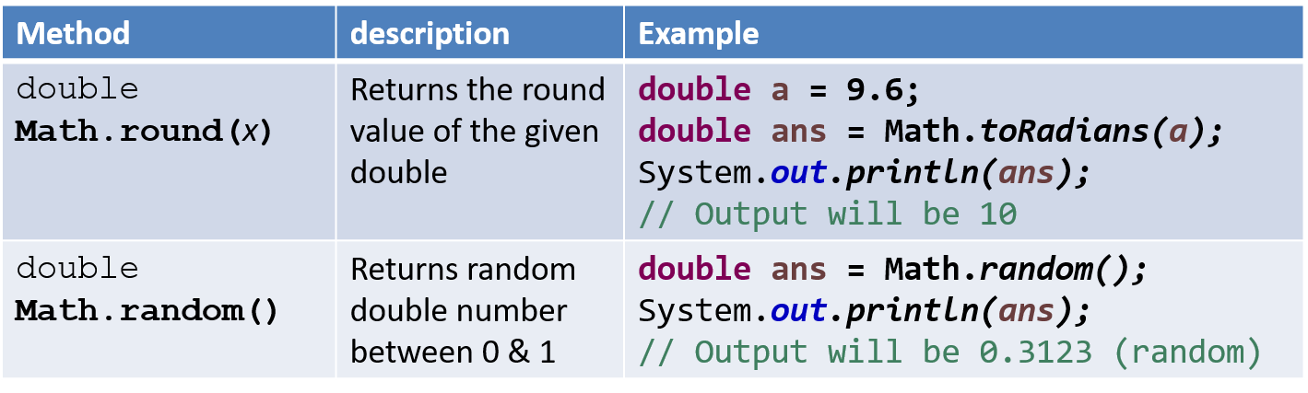
Methods of class Math (Cont.)

Slide 170
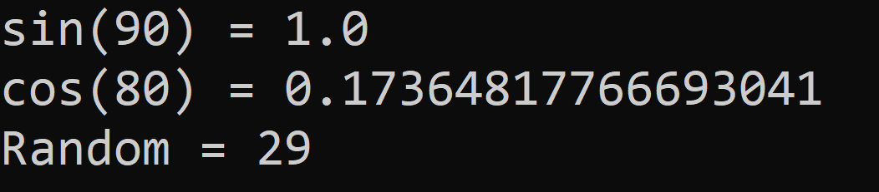
Math Example
public class MathDemo {
public static void main(String[] args) {
double sinValue = Math.sin(Math.PI / 2);
double cosValue = Math.cos(Math.toRadians(80));
int randomNumber = (int)(Math.random() * 100);
// values in Math class must be given in Radians
// (not in degree)
System.out.println("sin(90) = " + sinValue);
System.out.println("cos(80) = " + cosValue);
System.out.println("Random = " + randomNumber);
}
}

Slide 171
Wrapper classes

Slide 172
Wrapper classes
A Wrapper class is a class whose object wraps or contains a primitive datatypes.
When we create an object to a wrapper class, it contains a field and in this field, we can store a primitive datatypes.
In other words, we can wrap a primitive value into a wrapper class object.
Use of wrapper class :
They convert primitive datatypes into objects.
The classes in java.util package handles only objects and hence wrapper classes help in this case also.
Data structures in the Collection framework, such as ArrayList and Vector, store only objects (reference types) and not primitive types.
An object is needed to support synchronization in multithreading.

Slide 173
Wrapper classes (Cont.)
Primitive datatype | Wrapper class | Example
byte | Byte | Byte b = new Byte((byte) 10);
short | Short | Short s = new Short((short) 10);
int | Integer | Integer i = new Integer(10);
long | Long | Long l = new Long(10);
float | Float | Float f = new Float(10.0);
double | Double | Double d = new Double(10.2);
char | Character | Character c = new Character('a');
boolean | Boolean | Boolean b = new Boolean(true);
Common Fields (Except Boolean):
MIN_VALUE : will return the minimum value it can store.
MAX_VALUE : will return the maximum value it can store.

Slide 174
Parsing the String
Using wrapper class we can parse string to any primitive datatype (Except char).
byte b1 = Byte.parseByte("10");
short s = Short.parseShort("10");
int i = Integer.parseInt("10");
long l = Long.parseLong("10");
float f = Float.parseFloat("10.5");
double d = Double.parseDouble("10.5");
boolean b2 = Boolean.parseBoolean("true");
char c = Character.parseCharacter('a');
Note : for Integer class we have parseInt not parseInteger

Slide 175
BigInteger and BigDecimal
The BigInteger class found in java.math package is used for mathematical operation which involves very big integer calculations that are outside the limit of all available primitive data types.
For example factorial of 100 contains 158 digits in it so we can’t store it in any primitive data type available.
There is no theoretical limit on the upper bound of the range because memory is allocated dynamically
import java.math.BigInteger;
public class DemoBigNumbers {
public static void main(String[] args) {
BigInteger bi = new BigInteger("1234567891234567891234567890");
System.out.println(bi); // will return 1234567891234567891234567890
}}

Slide 176
BigDecimal
The BigDecimal class found in java.math package provides operation for arithmetic, comparison, hashing, rounding, manipulation and format conversion.
This method can handle very small and very big floating point numbers with great precision.
BigDecimal bd = new BigDecimal("111111.000000000000000000025");
System.out.println(bd); //111111.000000000000000000025

Slide 177
Autoboxing and Unboxing

Slide 178
Thank You

